Slide 1

Bioreactor System (5)
Advanced Control Technology
SoSe 2019
Presented by Md. Saiful Islam Sajol (30042836)
Sayed Rafay Bin Shah (30043073)
15.07.2019

Slide 2

Assignment 1
Objectives
To build a model of the system in Matlab/Simulink.
Linearize the system model in a suitable operation point.
Analyze the system behavior, i.e. stability, controllability, observability.
Design a state space controller by pole placement approach.
Analyze obtained results.
Slide | 1

Slide 3
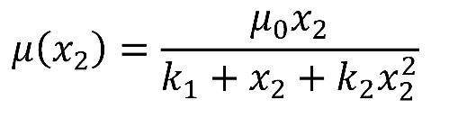

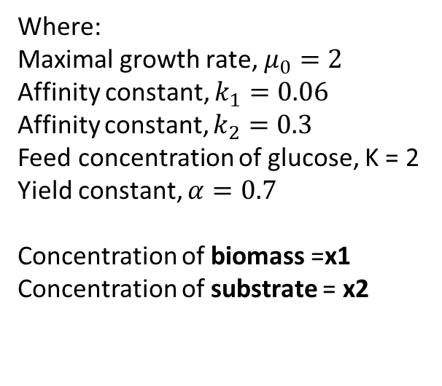
Bioreactor
Fig. 1: Bioreactor system
Where:
Maximal growth rate, $μ_{0}=2$
Affinity constant, $k_{1}=0.06$
Affinity constant, $k_{2}=0.3$
Feed concentration of glucose, K = 2
Yield constant, $α=0.7$
Concentration of biomass =x1 Concentration of substrate = x2
The Bioreactor system can be modeled by the following state space equation:
Where,
Slide | 2

Slide 4
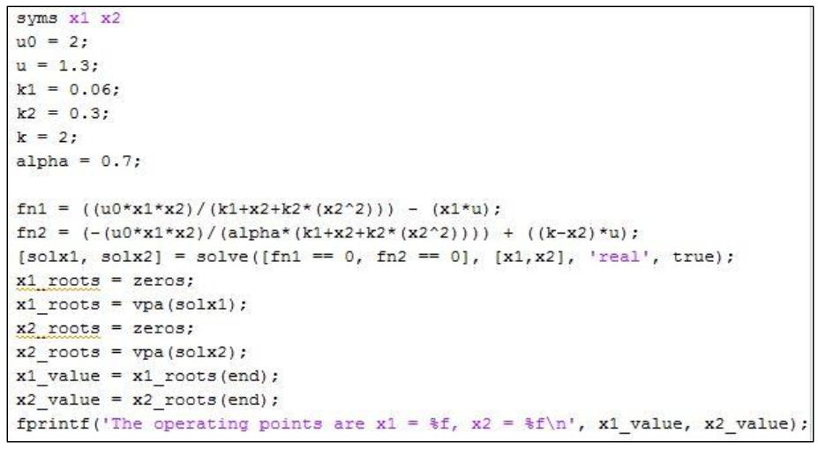
Linearization of the System Model in a Suitable Operation Point
By finding suitable operating points, the system can be linearized
𝒙̇ (𝑡) = 𝑨𝑥(𝑡) + 𝑩𝑢(𝑡) 𝒚(𝑡) = 𝑪𝑥(𝑡) + 𝑫𝑢(𝑡)
Where, A is the state matrix, B is the input matrix, C is the output matrix, D is the direct transmission matrix
By taking the system dynamics as zero, the operating points are calculated
The input value of u is arbitrarily chosen equal to 1.3
The values are obtained as follows:
x1= 0.22714 x2 =1.675505
Slide | 3

Slide 5
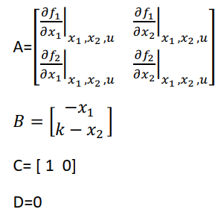
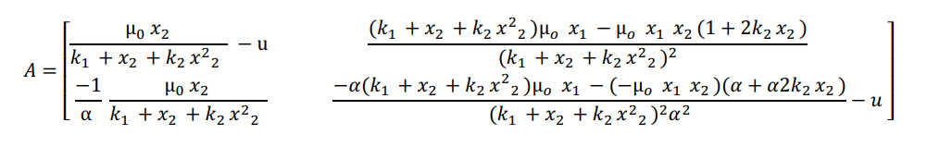
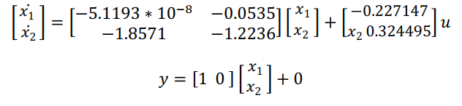
Linearization of the System Model in a Suitable Operation Point
With the help of Taylor´s Series we can linearize the non-linear model around the operating points
The linear state space representation
Slide | 4

Slide 6
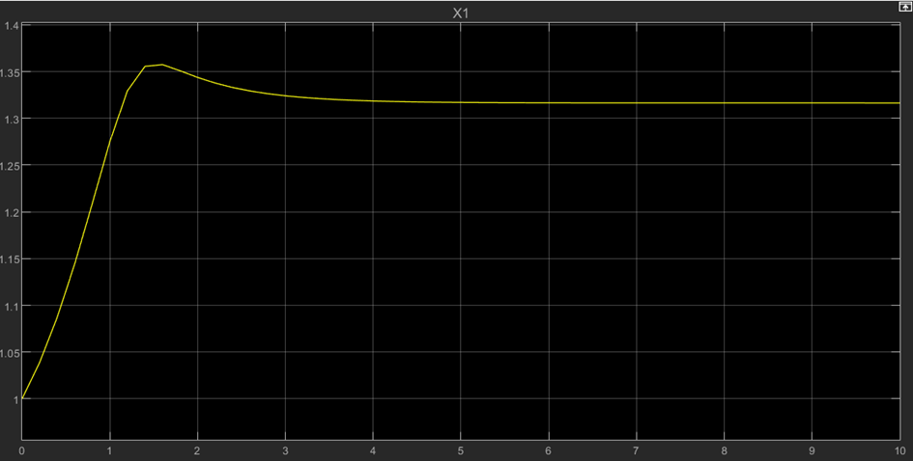
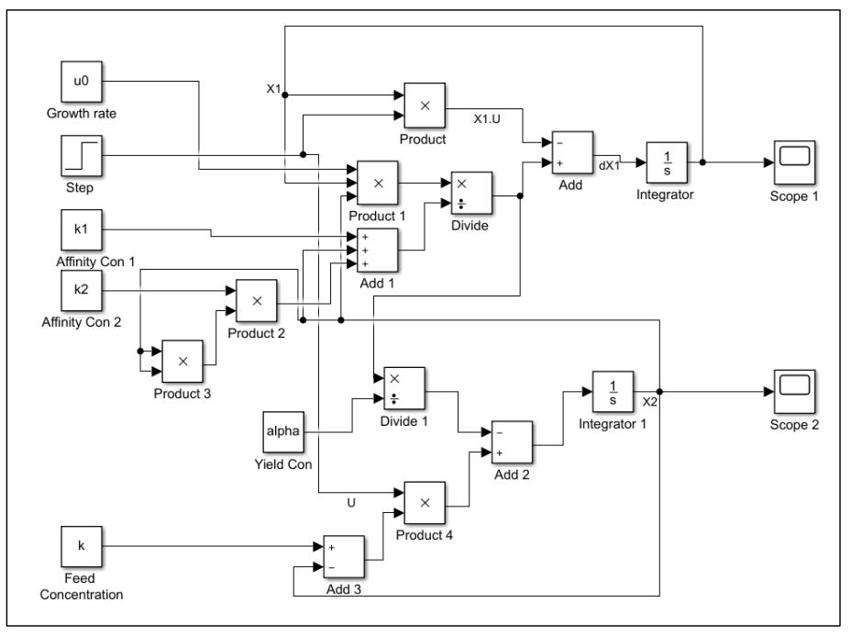
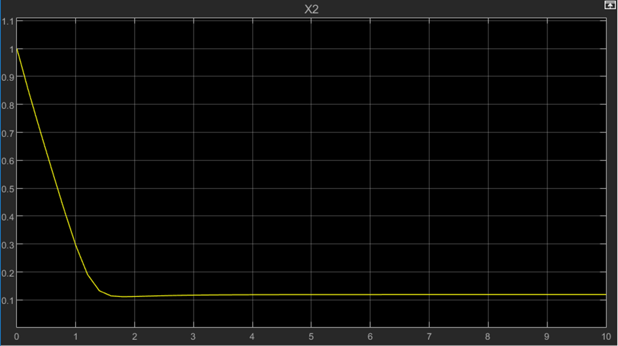
Simulink Model of Bioreactor System
Fig. 3: Output graph of scope 1 (Value of x1)
Fig. 2: Nonlinear model of the Bioreactor system in Simulink
Fig. 4: Output graph of scope 2 (Value of x2)
Slide | 5

Slide 7
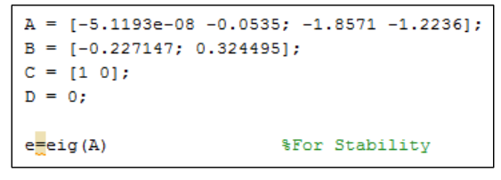
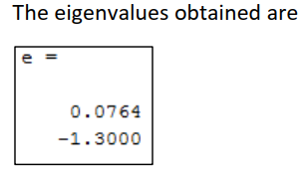
Analysis of the System Behavior
Stability
We compute the eigen values of A matrix
If : Eigen values are both negative → stable
Else : the system→ unstable
the eigenvalues of the matrix A are determined using the MATLAB script
This means the system is unstable
Slide | 6

Slide 8
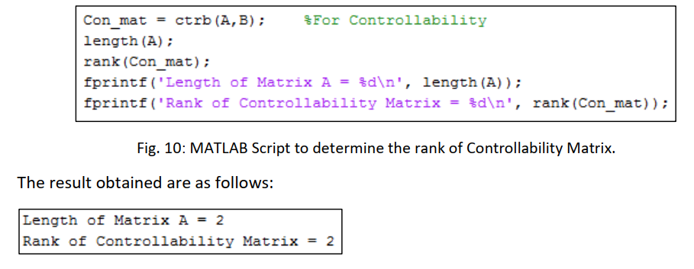
Analysis of the System Behavior (Contd.)
Controllability
we need to find the rank of the Controllability matrix 𝐶𝑚 which is defined by
𝐶𝑚 = [𝐵 | 𝐴𝐵]
If : rank of 𝐶𝑚 = length of matrix A → controllable Else : not controllable
The result obtained are as follows:
Hence, the system is controllable.
Slide | 7

Slide 9
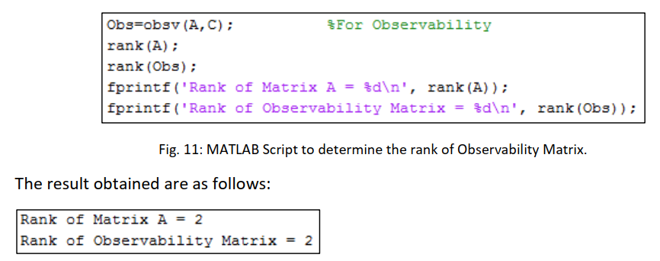
Analysis of the System Behavior (Contd.)
Observability
We need to find the rank of the Observability matrix 𝑂𝑚,
𝑂𝑚 = [𝐶∗ | 𝐴∗ 𝐶∗]
If : rank of 𝑂𝑚 = rank of matrix A → observable
Else : not observable
The result obtained are as follows:
Hence, the system is observable
To sum up, the bioreactor system is unstable but controllable and observable
Slide | 8

Slide 10
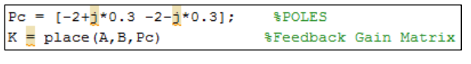
Design of State Space Controller
Design of State Space Controller using Pole Placement Approach
𝒙̇ (𝑡) = 𝑨𝑥(𝑡) + 𝑩𝑢(𝑡) 𝒚(𝑡) = 𝑪𝑥(𝑡) + 𝑫𝑢(𝑡)
control signal , u= -Kx
K = State feedback gain matrix
The feedback gain matrix K is determined for various poles using MATLAB
For Poles, Pc = -2+0.3j, -2-0.3j
Similarly, for Poles, Pc = -2+5j, -2-5j The K matrix is, K = [-2.0223 -1.4156]
The K matrix is, K = [-4.6024 -3.2208]
Slide | 9

Slide 11
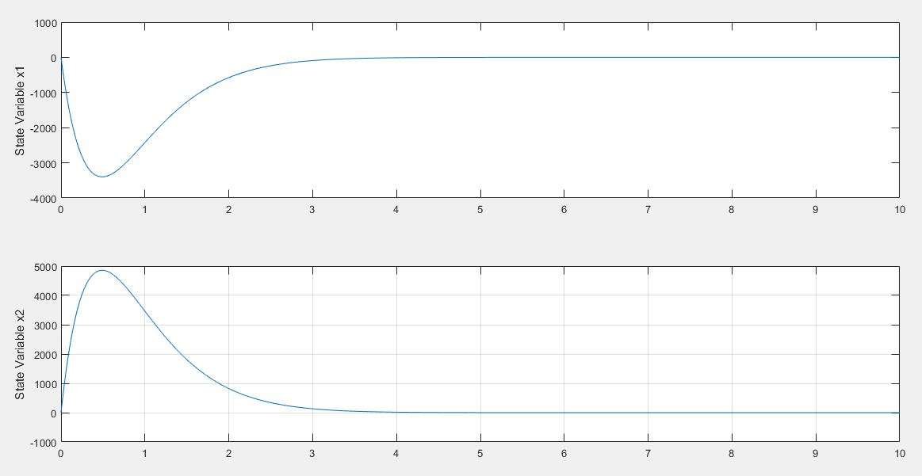
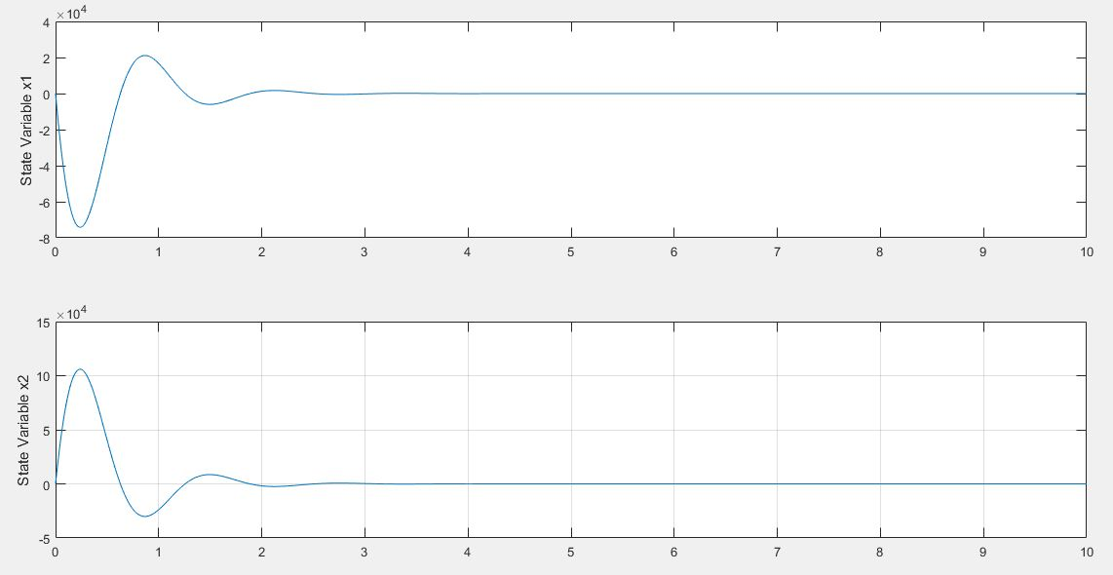
Design of State Space Controller (Contd.)
Design of State Space Controller using Pole Placement Approach
steady state at approx. 2.5 sec
Fig. 5: Controller Response for Poles -2+0.3j, -2-0.3j
steady state at approx. 3.2 sec
Poles at 2+0.3j, -2-0.3j are selected for designing the state space controller.
Fig. 6: Controller Response for Poles -2+5j, -2-5j.
Slide | 10

Slide 12



Design of State Space Observer
Design of State Space Observer using Pole Placement Approach
K=state feedback gain matrix
Ko= observer gain matrix
At first, the observer feedback gain matrix is determined for two arbitrarily chosen set of poles using the script
For Poles, Po = -10, -11
Similarly for Poles, Po = -5, -6
Slide | 11

Slide 13
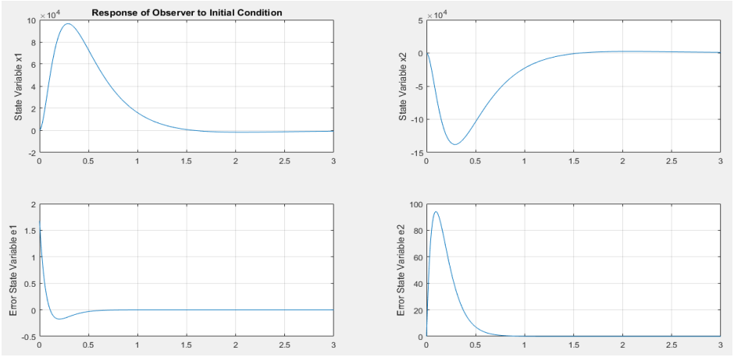
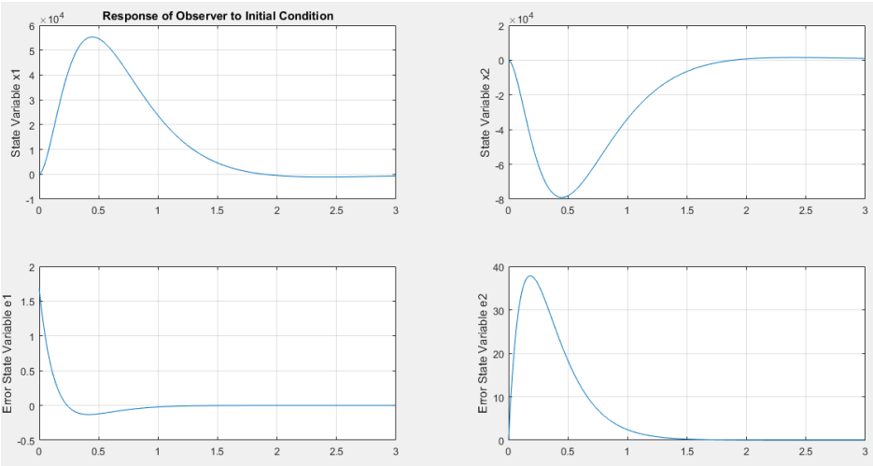
Design of State Space Observer (Contd.)
Initial response of the observer for different pole position
stabilize at approx. 2 sec
Fig. 7: Observer Response to Poles at -10, -11.
stabilize at approx. 1.5 sec
Fig. 8: Observer Response to Poles at -5, -6.
Slide | 12

Slide 14
Bioreactor System_(5)
THANK YOU!
Slide | 26
Md. Saiful Islam Sajol (30042836) | Sayed Rafay Bin Shah (30043073)

